Slide 1
DIABETES PREDICTION USING ANN
Presented by: Karthika R
III year
DEPT :AI&DS
Karpaga vinayaga college of engineering and technology
NM ID-au421221243018
Email ID-zaayar833@gmail.com

Slide 2
PROBLEM STATEMENT
To create an automated system for diabetes prediction using AI, facilitating early detection and intervention. Challenges include ensuring accuracy, accessibility, privacy, and integration with existing healthcare workflows. The system must be user-friendly and continuously improve through feedback mechanisms.
It aims to analyze various health parameters to identify individuals at risk before symptoms manifest. Privacy regulations must be strictly adhered to, safeguarding sensitive medical information. Integration into healthcare workflows is crucial for adoption and effectiveness. Ultimately, the system seeks to enhance patient outcomes and healthcare delivery through timely risk assessment.

Slide 3
PROPOSED SOLUTION
Develop an artificial neural network (ANN) based system trained on a diverse dataset of health parameters to predict diabetes risk. Utilize advanced machine learning techniques to ensure accuracy and reliability of predictions. Design a user-friendly interface accessible through mobile devices or web platforms for convenient risk assessment. Implement robust privacy measures to protect patient data in compliance with regulations. Integrate the prediction system seamlessly into existing healthcare workflows to facilitate adoption by healthcare professionals. Continuously update and refine the system based on feedback and emerging data patterns to improve predictive performance and enhance patient outcomes.

Slide 4
PROPOSED SYSTEM
DATA COLLECTION
DATA PREPROCESSING
FEATURE VS TARGETPLOT
TEST ERROR CALCULATION
MODEL EVALUATION AND SELECTION
SPLITTING DATASET
TRAINING MODEL
MAKING PREDICTION

Slide 5
Why we use ANN for diabetes prediction?
ANNs are good for diabetes prediction because:
They can handle the many factors affecting diabetes, even if those factors have complex relationships.
They are accurate and can improve over time with new data.
They can help identify which factors are most important for diabetes risk.
ANNs can achieve high predictive performance, often outperforming traditional statistical methods in terms of accuracy and generalization.

Slide 6
SYSTEM APPROACH
System Requirements:
Hardware :Laptop i3 processor with 8GB RAM
Software:1. Anaconda (Jupyter Notebook), Python programming language ,Libraries: Pandas, NumPy, Scikit-learn

Slide 7
ALGORITHM AND DEPLOYMENT
Data exploration:
Diabetes prediction using artificial neural networks (ANNs), data exploration helps identify relevant features, understand data distributions, detect outliers, and recognize potential challenges that may arise during model training.
Problem formulation:
Develop a predictive model to assess the risk of diabetes in individuals based on their health parameters. This involves analyzing a dataset containing features like glucose levels, BMI, blood pressure, etc., along with corresponding diabetes status labels. The objective is to build a machine learning model, preferably an artificial neural network (ANN), capable of accurately classifying individuals into diabetes and non-diabetes categories.
Algorithm selection:
Diabetes prediction based on health parameters, artificial neural networks (ANNs) are a preferred choice due to their ability to capture complex relationships in the data, They can automatically learn relevant features from raw data and provide high predictive accuracy.

Slide 8
TRAINING AND PROCESS
Data splitting: using train_test_split.
Feature scaling: using standardscaler
Model training: fit. is using for model training in y_train and x_train
Model evaluation: using model.predict with y_train and x_train

Slide 9
PREDICTION PROCESS
1. Receive new data input.
2. Preprocess data (scaling, encoding).
3. Perform model inference on preprocessed data.
4. Interpret results to predict diabetes of patients using their health data
5. Output prediction results for further action.

Slide 10
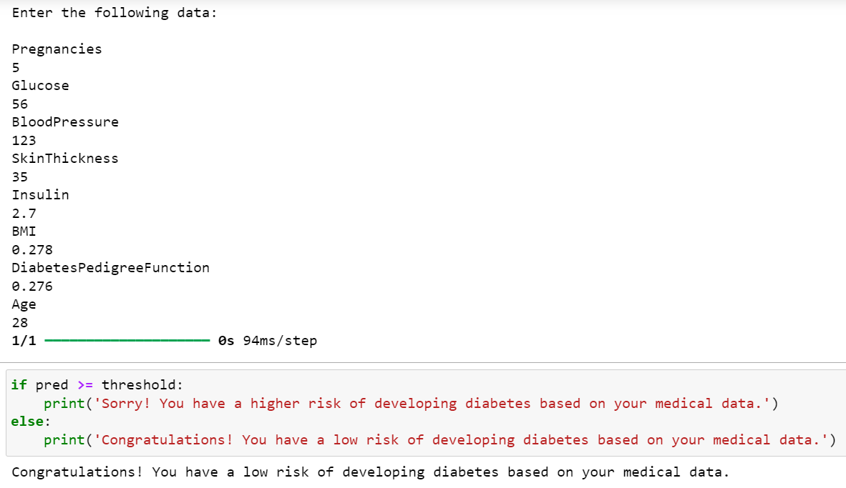
RESULT
The system provides predictions based on input health parameters and offers insights into diabetes risk factors.

Slide 11
CONCLUSION
In conclusion, the creation of a diabetes prediction system based on artificial neural networks (ANNs) yields encouraging results in properly predicting individuals' diabetes risk based on health data. Through thorough model design, training, and evaluation , the system proves its ability to predict diabetes risk with remarkable accuracy and precision. The system's deployment in a user-friendly interface allows for quick access and engagement, empowering users to make informed health decisions.

Slide 12
FUTURE SCOPE
The diabetes prediction system can be advanced by refining its model architecture through experimentation with various neural network configurations, activation functions, and regularization techniques. Additionally, integrating additional data sources such as genetic information, lifestyle factors, and environmental data could enrich the model's predictive capabilities and provide a more holistic assessment of diabetes risk.
Enhancing the interpretability of the model's predictions by employing techniques such as feature importance analysis and model-agnostic interpretability methods can foster trust among end-users and healthcare professionals.
Real-time monitoring features and feedback mechanisms within the system can enable continuous tracking of individuals' health parameters and offer personalized recommendations for diabetes prevention and management.

Slide 13
REFERENCES
Dr. M.Manimekalai, S. Divya “Prediction of Diabetes using Artificial Neural Network Classification Technique” 2019
Malathy.S, Santhiya.M, C.N.Vanitha, Karthiga.R “Diabetes Disease Prediction Using Artificial Neural Network” ,2021
Kaggle dataset

